Slide 1
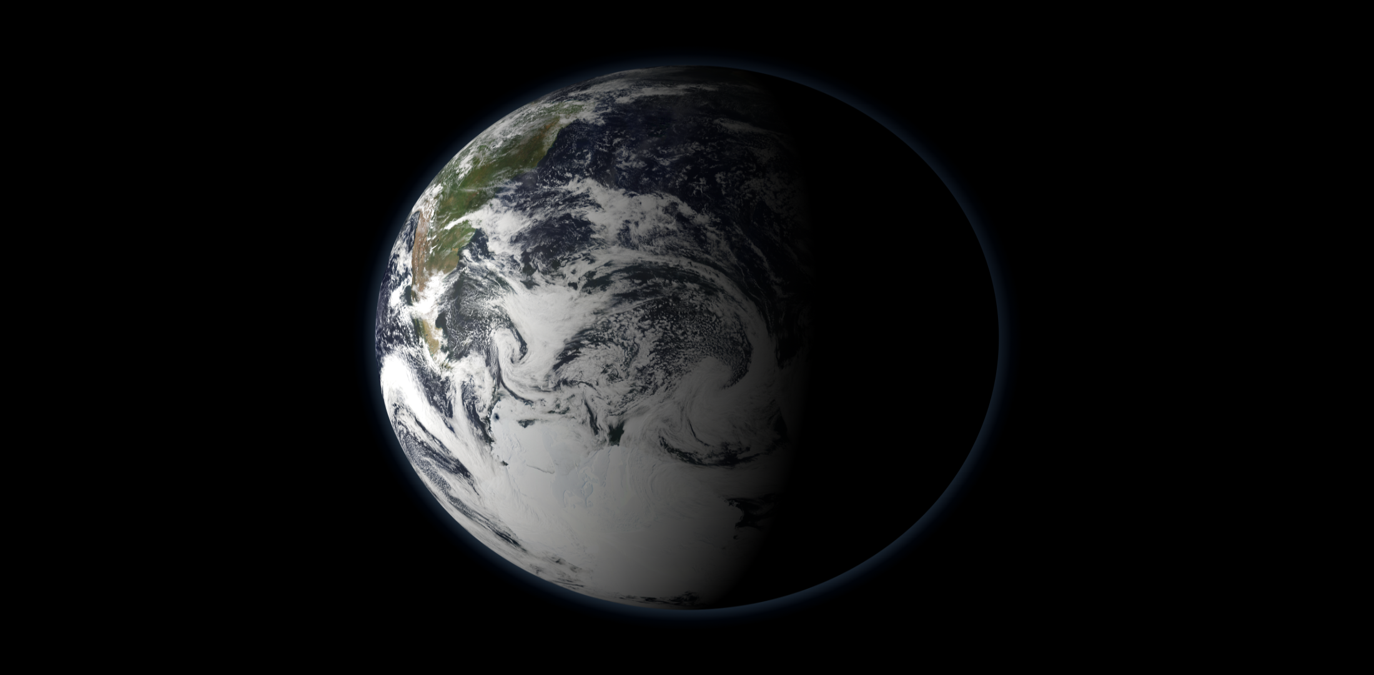


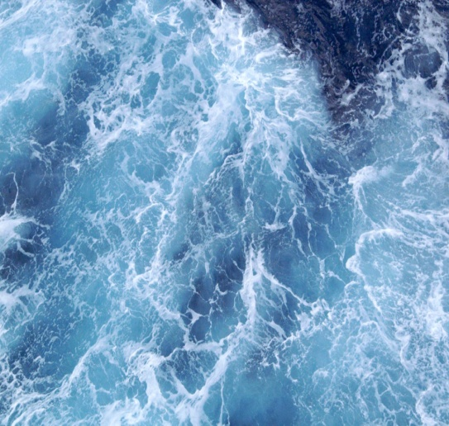



BLUE TO GREEN OCEAN REVOLUTION
Carbon fluxes in selected sites of Bay of Bengal and Southern Ocean and their significance
Ocean Fertilization using Iron flakes
Understanding the present
Biogeochemistry Group
CSIR-National Institute of Oceanography, Donapaula, Goa

Slide 2
Outline
Oceans Role in the Global Carbon Cycle
  & iron’s role in ocean C cycle
Ocean Iron Fertilization Experiments
  - lessons learned
Ocean fertilization using Flakes

Slide 3
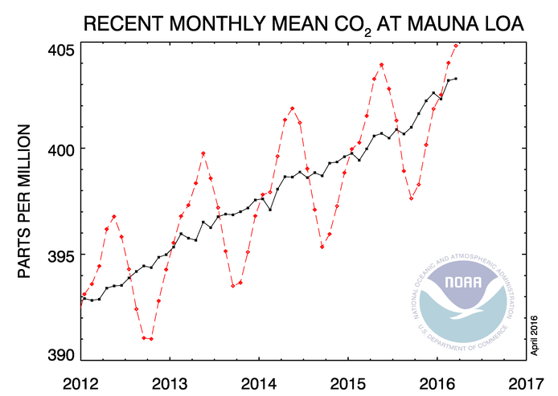
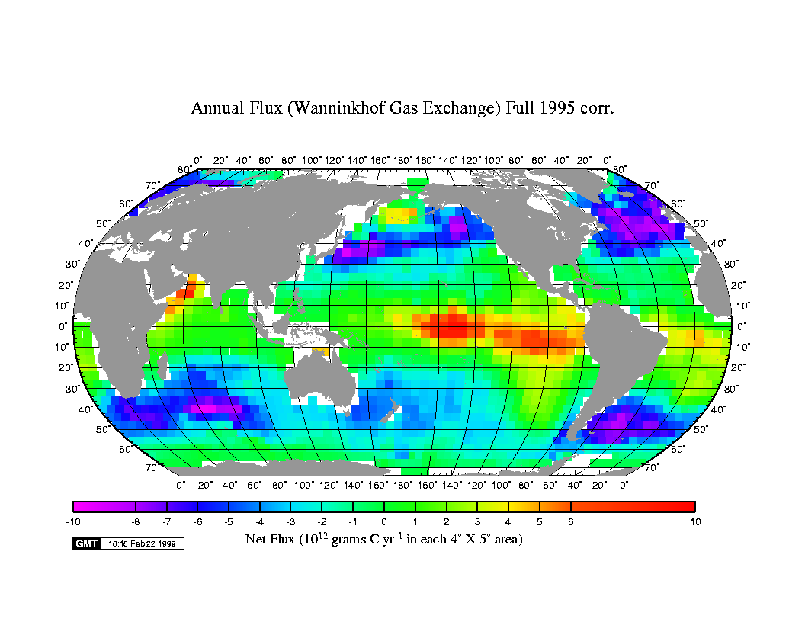
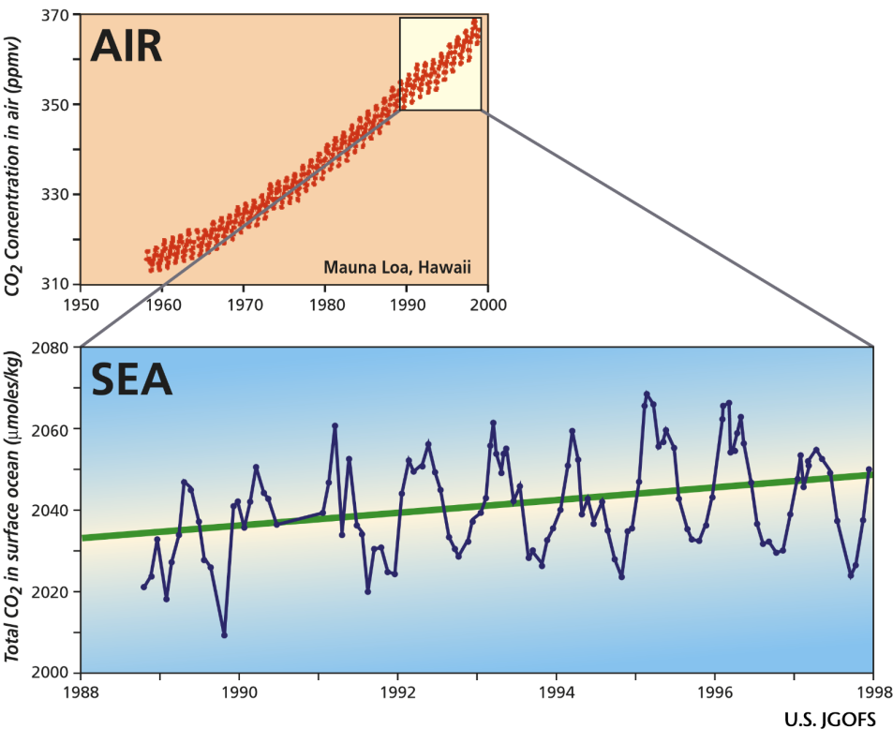
Ocean acts as sink for CO_{2;} removes 1/3rd of anthropogenic atmospheric CO₂
Saturation of the Southern Ocean CO₂ sink due to recent climate change---- Le Quere et al., 2007

Slide 4
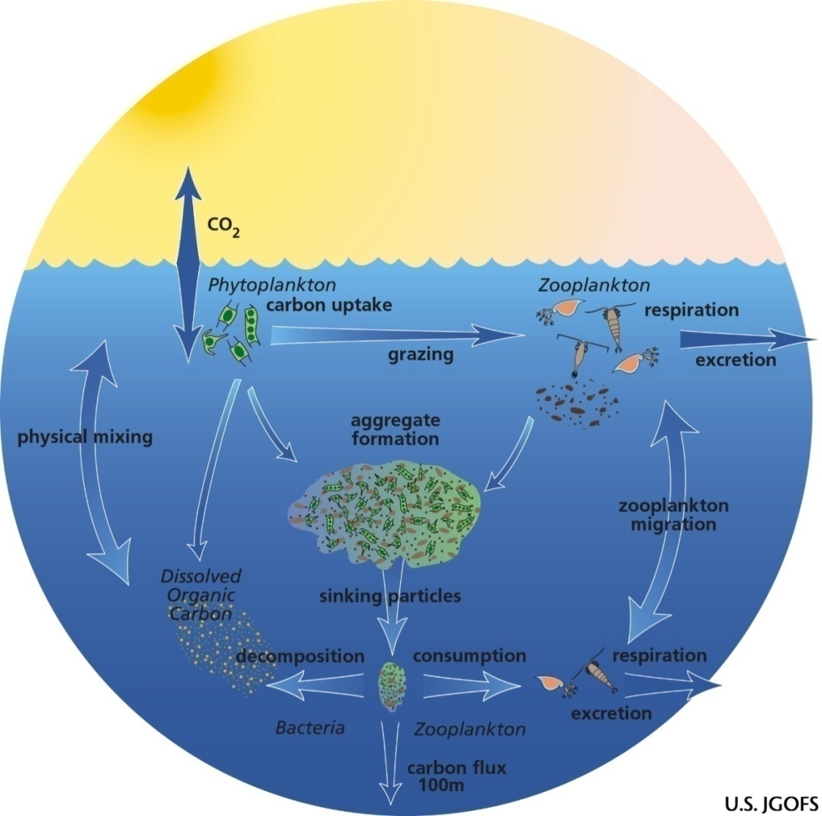
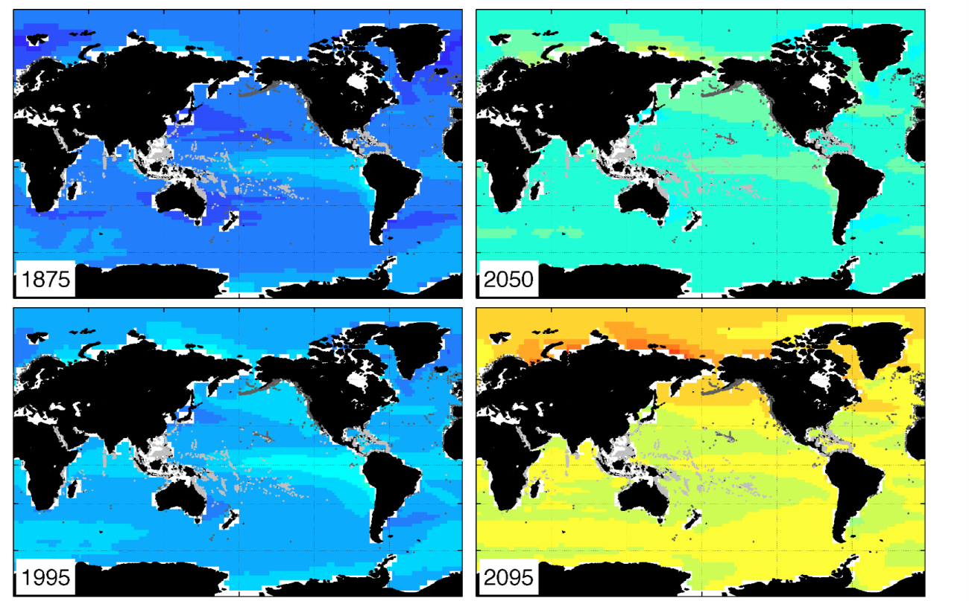
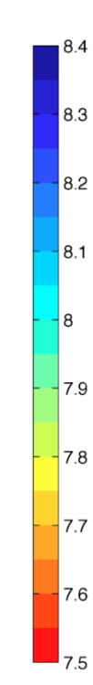
Biological Pump
Solubility Pump
Increasing carbon dioxide will result in reducing the amount of carbonate ion (ocean acidification).
Aragonite saturation depth is becoming shallower.
Feely et al., 2009
pH
Biological processes transfer organic matter to depth
Quickly removes CO₂ from surface ocean & atm.

Slide 5

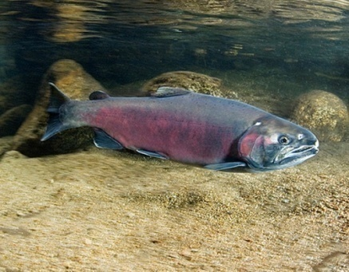
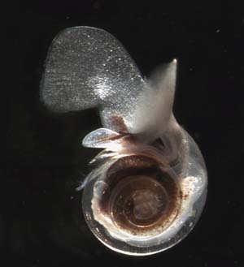
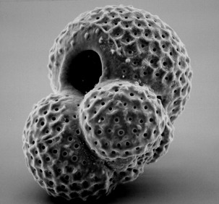
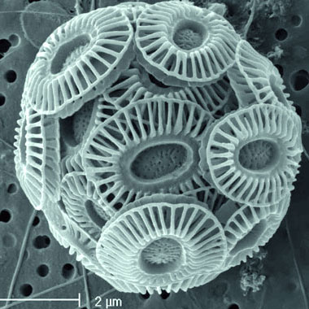
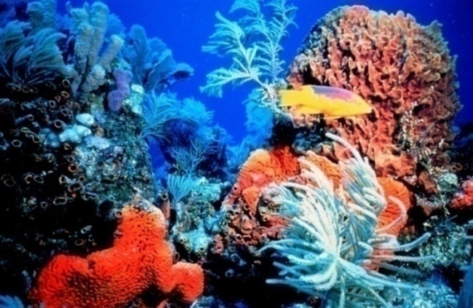
Who will be affected?
Carbonate is used by marine organisms like this Pteropod, Coccolithophore, Foraminifera,
Sea urchins to build their shell.
4 to -8% decline in calcification at pCO₂= 560 ppm
Bijma et al. (2002)
Sensitive ecosystems like coral reefs may decline due to change in pH.

Slide 6
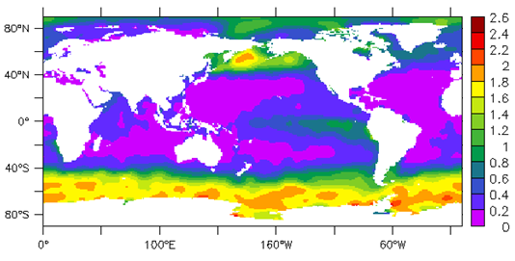
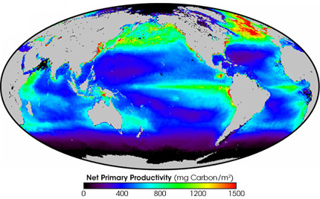
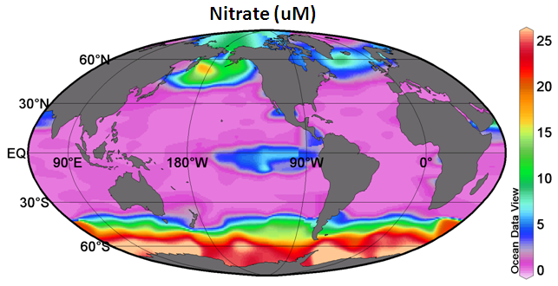
What controls carbon uptake by algae?
i.e. primary productivity
Phosphate (uM)
Aumont 2006
Light, temperature, mixing
Major nutrients (N, P, Silica)
Grazing
Micro-nutrients (Fe)

Slide 7
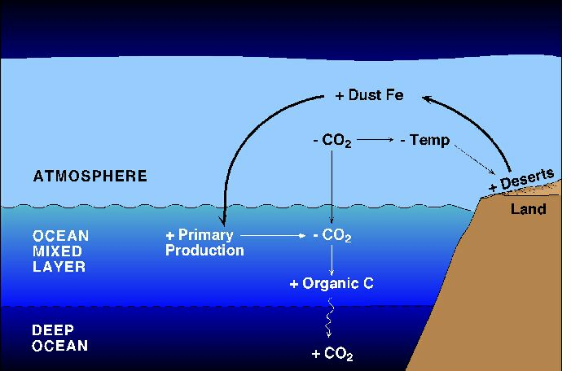
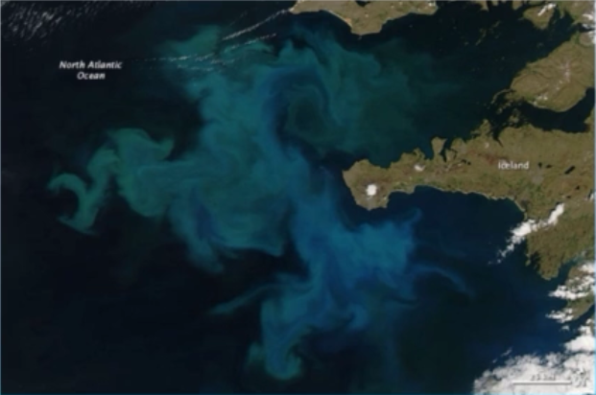
Iron Hypothesis
- 40% of ocean “HNLC”
- high nutrient, low chlorophyll & low Fe
The Vostok ice core record (Petit et al., 1999)
Past climate shows correlations
high dust = lower CO₂ = lower temp
“Give me half a tanker of iron and I’ll give you the next ice age” - J. Martin, 1990

Slide 8
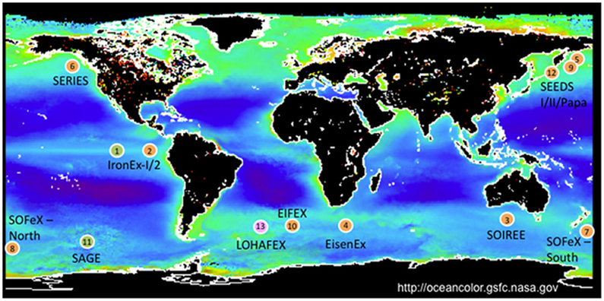
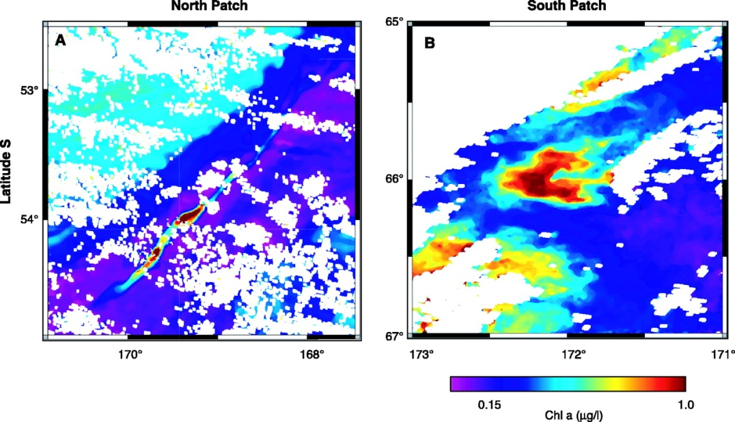
Ocean Iron Fertilization Experiments
LOHAFEX 2009, Thiele et al., 2012
EIFEX 2004, Smetacek et al., 2012
SoFex Experiment, Coale et al., Science, 2002.

Slide 9
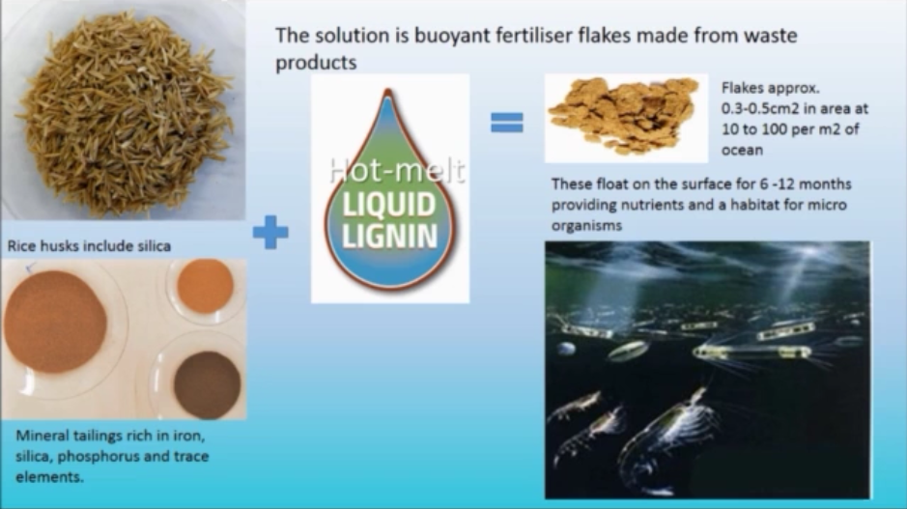
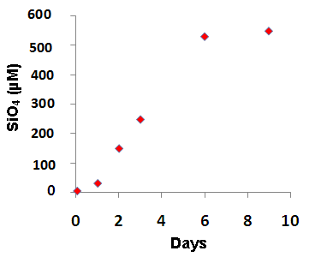
Present concept: Buoyant flake fertilization
Lab experiment on Rice husk

Slide 10
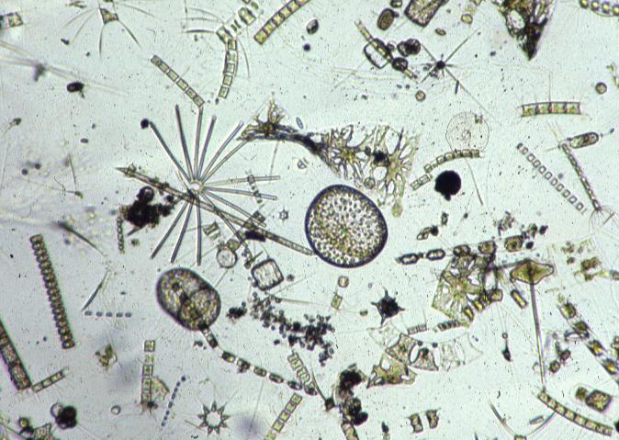
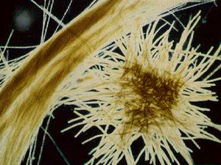
C : N : P : Fe
Present Concept
Cyanobacteria 5500 : 1000 : 20 : 1
Diatoms 47000 : 7000 : 800 : 1
Fe
N₂
Endless source of nitrogen
atmosphere
DIAZOTROPHY
ocean
N₂ + 8H ⁺ + 8e⁻ → 2 NH₃ + H₂
NH₃
‘New’
Nitrogen
Prokaryotes
Sustains ‘new’ primary production
Diatoms
Diazotrophs (prokaryotes)

Slide 11
Objectives
To test the efficacy of Iron Flakes for CO₂ sequestration
To study the unintended consequences of deliberate Fe additions such as eutrophication

Slide 12
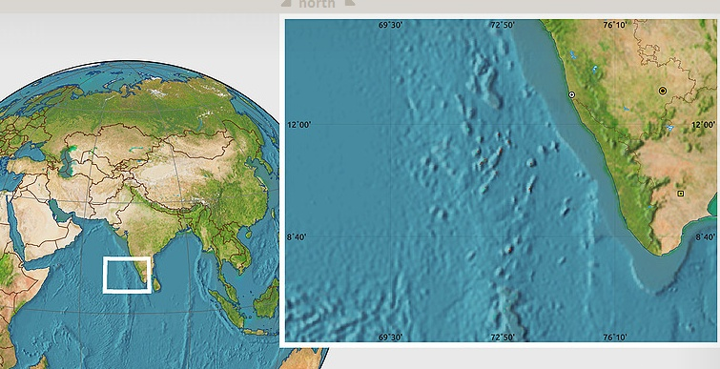
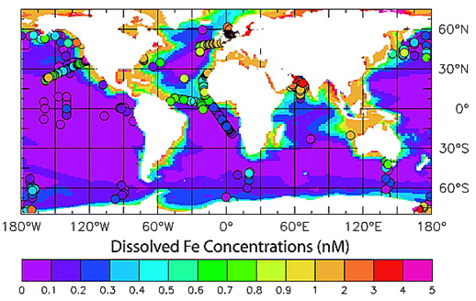
Mesocosm & Lab Experiments

Slide 13
Measurements
Temperature and Salinity
Dissolved Oxygen
Climatically important gases like Carbon dioxide, Nitrous Oxide, Methane, di-methyl sulphide
Macro and Micronutrient (Nitrate, Nitrite, Phosphate, Silicate, Ammonium, Iron)
Total organic Carbon and Organic Nitrogen
Inorganic carbon parameters like (Total Inorganic carbon, pH, Alkalinity)
Air Sea CO₂ Fluxes
Vertical carbon export fluxes
Phytoplankton
Primary Productivity
Chlorophyll
Pigments (HPLC method)
Zooplankton

Slide 14
Expected Outcome
Efficacy of Iron flakes will be tested for carbon sequestration
102 kg of Carbon would be fixed and 0.37 tons CO₂ would be sequestered by adding 62 g flakes.
Risks and benefits of Ocean Iron Flake Fertilization
Anticipated Future large scale flake fertilization
Increase in the fish biomass
Increase in DMS production
Reduction in acidification
Societal benefit
Transform the low grade mineral ore waste into valuable resources
Possible solution to control the rising CO₂ levels and hence global temperatures

Slide 15
Financial Requirements:
  Rs. in Lakhs
Resource | 2017-18 | 2018-19
Equipment | 15
Consumables | 22.5 | 5
Manpower (permanent) | 1.4 | 11
Temporary man power (4 nos) | 12 | 12
Travel (India) | 4 | 1
Contingency | 8 | 2
(A) Sub-total | 62.9 | 31
(B) Ship-time* | 200 | 200
Overhead 40% (excluding shiptime) | 25.16 | 12.4
Grand Total (A+B) | 288.06 | 243.4
Total project cost: 531.46 lakhs

Slide 16
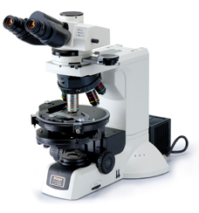
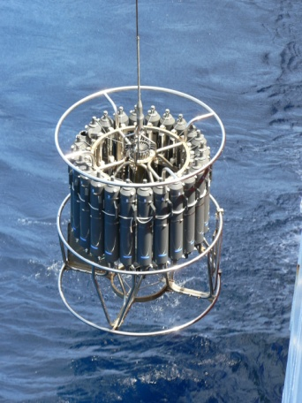
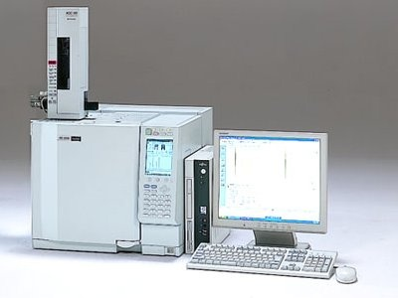
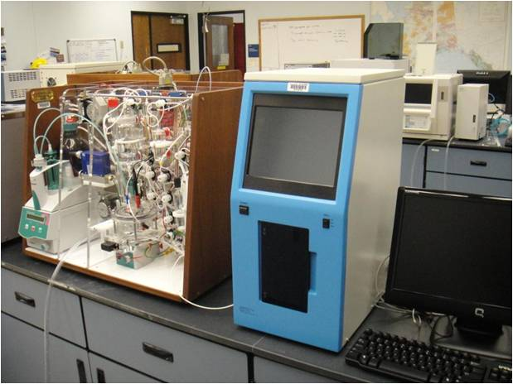
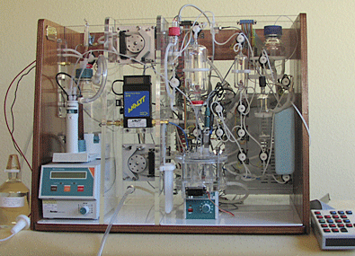
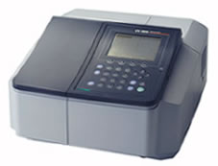
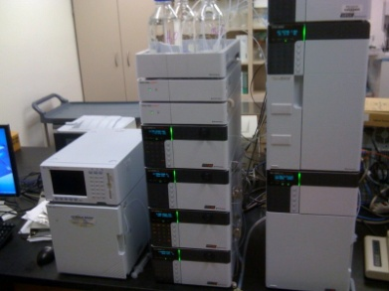
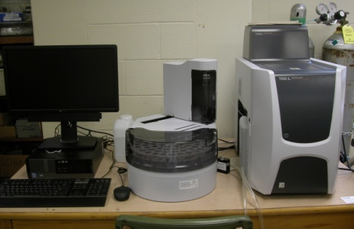
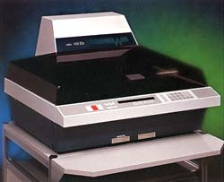
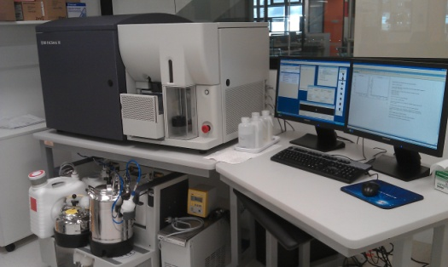
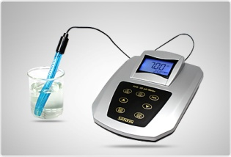
Facilities available with our Group
COULOMETER
GAS CHROMATOGRAPHY
CTD with samplers
MICROSCOPES
SPECTROPHOTOMETER
HPLC
VINDTA-ALKALINITY SYSTEM
TOTAL ORGANIC CARBON ANALYZER
pH METER
SCINTILLATION COUNTER
FLOW CYTOMETER

Slide 17
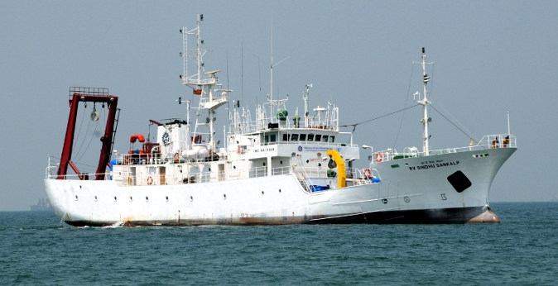
Thankyou

